Slide 1

16/11/2022
Test Your SAP Cloud Application Programming
Model–Based Apps Locally
Geert-Jan Klaps – SAP Innovation Architect & SAP Mentor

Slide 2
Agenda – What can you expect
How this project got started
Introducing the cds-launchpad-plugin
Incorporating the cds-launchpad-plugin in your own projects
Demo
Wrap-up
Q&A

Slide 3
How this project got started

Slide 4



How this project got started – Personal interest & observations
Working on multiple SAP Cloud Application Programming Model-based projects
Performing same actions in each project
Copy Fiori Launchpad Sandbox HTML page
Setting up a FioriSandboxConfig.json file
Learning TypeScript
Looking into reusable component development with Nodejs

Slide 5

How this project got started – Some questions kept popping up
Why am I repeating the same process for each and every project?
What if for some reason the HTML for the Fiori Launchpad Sandbox needs to change?
Why am I maintaining the config file, while this information is already available in the project?
How can I easily validate my project’s UI configuration?

Slide 6

How this project got started – The idea
Reusable solution
Generate Fiori Launchpad Sandbox
Leverage only SAP CAP / SAPUI5 standard project configuration
Allow project specific configuration
SAPUI5 theme
SAPUI5 version
Integrated in CAP development tools
Built using TypeScript (personal challenge ☺)
Open-source

Slide 7



How this project got started – Why open-source?
Start from a basic idea
Different views, opinions, use-cases, …
Collaborate with a common goal
Better final solution

Slide 8
Introducing the cds-launchpad-plugin

Slide 9
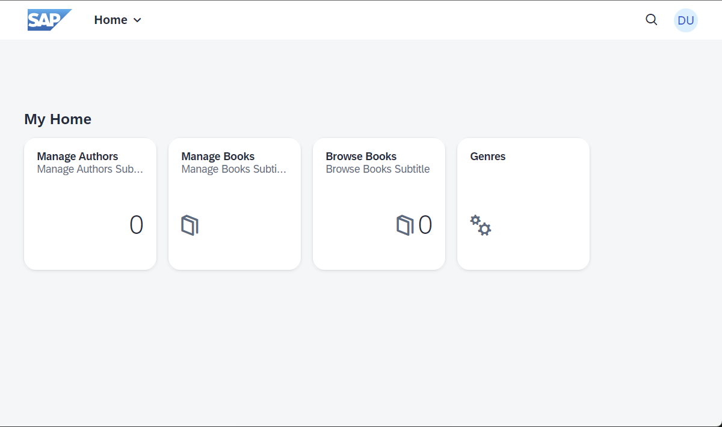
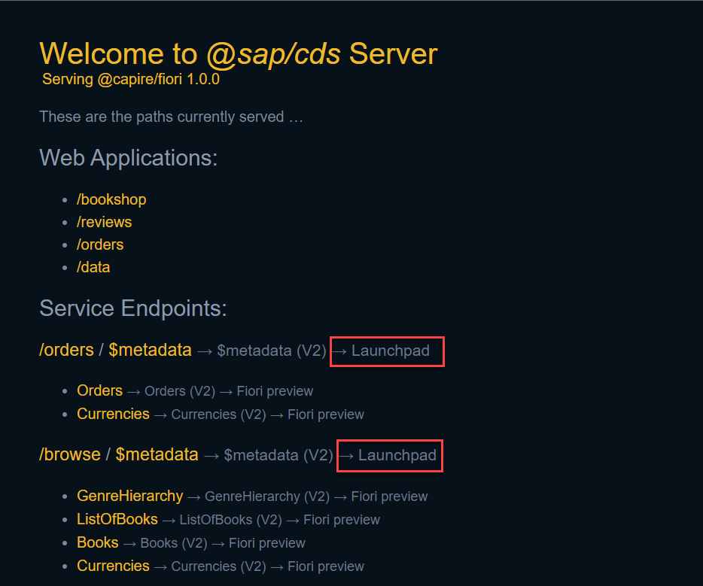
Introducing the cds-launchpad-plugin – What is it?
Plugin for SAP Cloud Application Programming Model (@sap/cds)
Compatible with Node.js-based CAP projects
Generated Fiori Launchpad Sandbox for testing / demo purposes
Plugin for CDS Server

Slide 10
Introducing the cds-launchpad-plugin – What it’s not?
A plugin to use productively
No authorization management
No user management
No personalization
No theming
…
A replacement for SAP Launchpad / SAP Work Zone Service

Slide 11
Introducing the cds-launchpad-plugin – Advantages
Easy to install
Improved developer efficiency
Easy to integrate in your project (only a few lines of code needed)
Implicitly validates your whole project configuration (in terms of UI)
Easily test your SAPUI5 apps & plugins
No manual configuration needed (if your project configuration is properly in place)
Create your own HTML Launchpad Sandbox but leverage generated appconfig file
Create your own appconfig file and merge it with the generated one

Slide 12
Incorporating in your own projects

Slide 13
Incorporating in your own projects – Overview
Install using a single command
npm install --save-dev cds-launchpad-plugin
Four important files for successfully using the plugin
server.js (CAP)
project.json (CAP)
manifest.json (SAPUI5)
i18n.properties (SAPUI5)

Slide 14
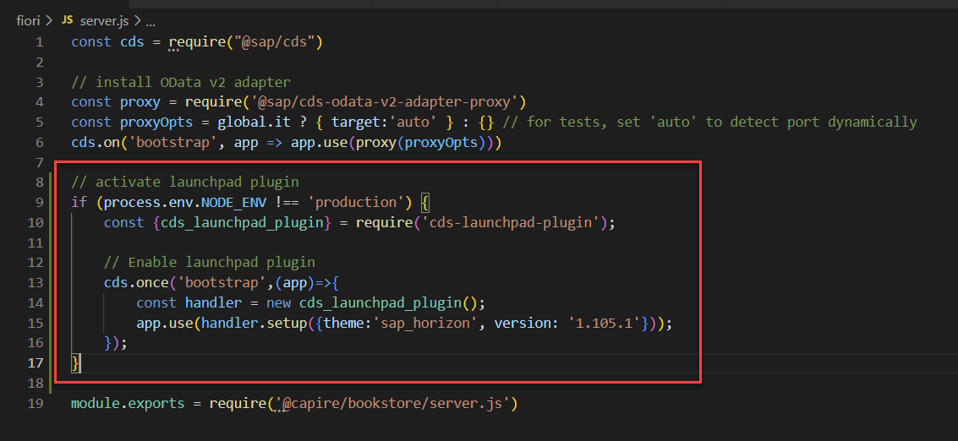
Incorporating in your own projects – server.js
Activate the plugin in non-production environments
Configuration object can be ommited

Slide 15
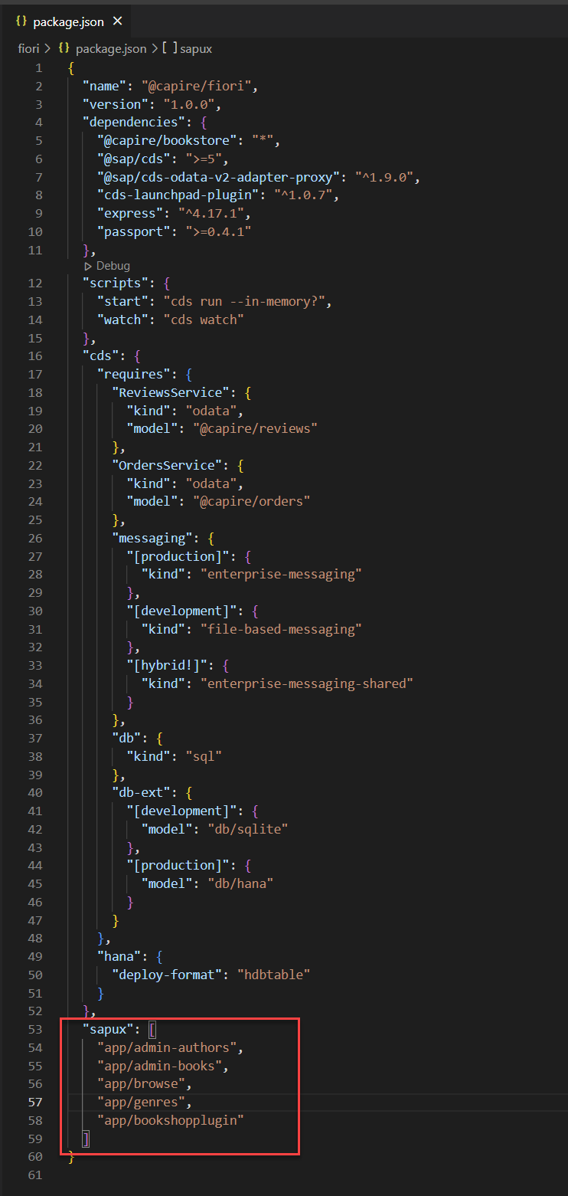
Incorporating in your own projects – project.json
Ensure sapux section contains paths to SAPUI5 apps
Should be automatically generated when using Fiori Tools

Slide 16
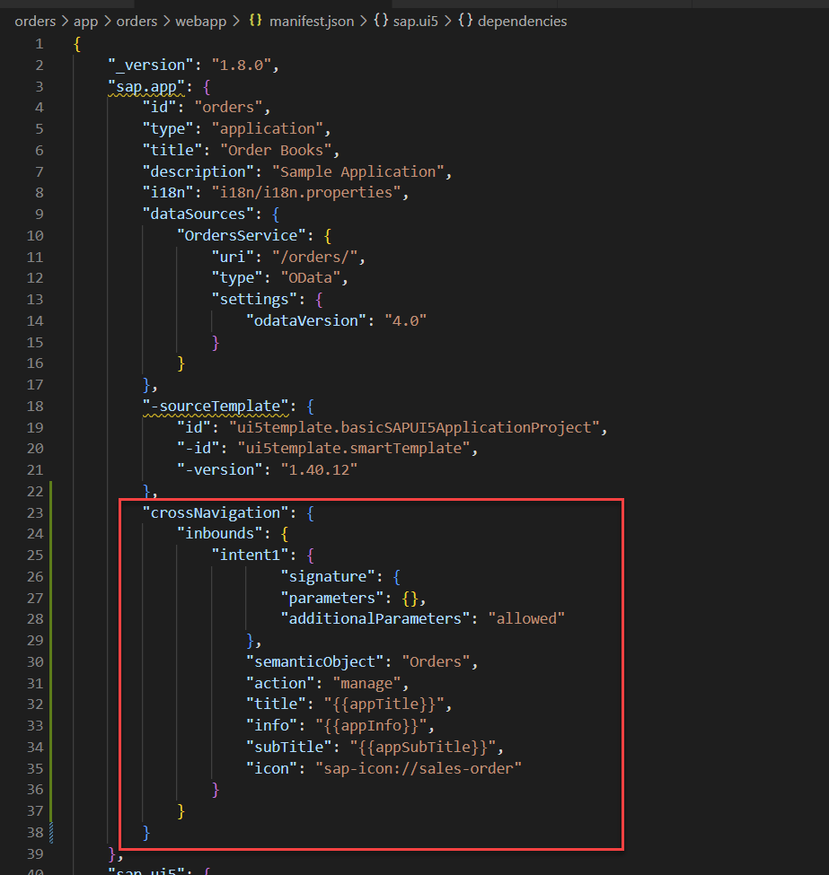
Incorporating in your own projects – manifest.json - Apps
Ensure an inbound tile configuration is present
Semantic Object
Action
Title
Info (optional)
Subtitle (optional)
Icon (optional)

Slide 17
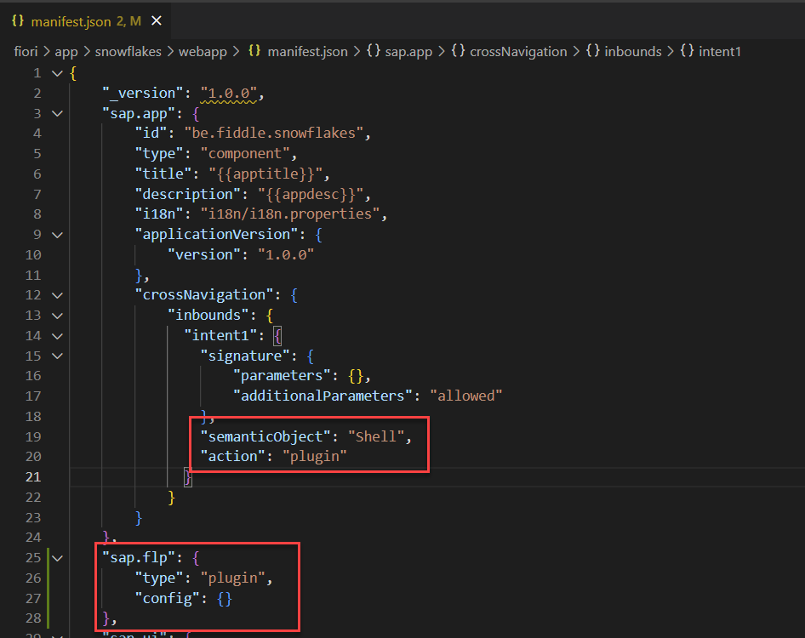
Incorporating in your own projects – manifest.json - Plugins
Ensure an inbound tile configuration is present
Semantic Object = Shell
Action = plugin
Ensure Launchpad Configuration is present
Type = plugin

Slide 18
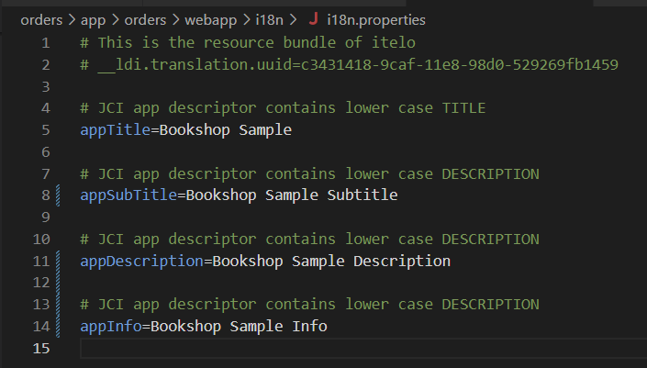
Incorporating in your own projects – i18n.properties
Supports multiple languages
Only needed if used in tile configuration

Slide 19
Demo

Slide 20
Demo – Demo repository
Available at https://github.com/geert-janklaps/cds-launchpad-plugin-demo
Branches
0-Base-Sample -> un-adapted bookshop sample
1-Launchpad-Plugin-Base -> activated cds-launchpad-plugin + project corrected
2-Launchpad-Plugin-SAPUI5-Launchpad-Plugin -> added snowflake plugin
3-Launchpad-Plugin-Merged-Config -> project config file merged with generated config file
Run sample with following command
npm run fiori
If login needed
User: alice
No password

Slide 21
Wrap-up

Slide 22
Wrap-up – Contributors
Sergei Haller (https://github.com/the-docta)
Multiple intents support
External / Merged appconfig file functionality
Dynamic tile support
Jibbril (https://github.com/Jibbril)
Launchpad Plugin support
Gregor Wolf (https://github.com/gregorwolf)
Support for SAPUI5 i18n bundleURL (fallback / supported locales configuration)
Ideas to improve the plugin are always welcome! ☺

Slide 23
Wrap-up – Overview
Quick installation
Easy to use
No more manual configuration needed
Leverages configuration that should be present anyway
Ensures project configuration is correct in terms of UI
Saves time / improves developer efficiency
Future proof

Slide 24
Wrap-up – Interesting links
GitHub: https://github.com/geert-janklaps/cds-launchpad-plugin
GitHub Demo Repository: https://github.com/geert-janklaps/cds-launchpad-plugin-demo
Solution Overview Blog: https://blogs.sap.com/2022/03/14/a-fiori-launchpad-sandbox-for-all-your-cap-based-projects-overview/

Slide 25
Q&A

Slide 26





Want to reach out?
https://people.sap.com/geert-jan.klaps
@geertjanklaps
@geertjanklaps@saptodon.org
https://www.linkedin.com/in/geertjanklaps
geert-jan.klaps@thevaluechain.eu

